Slide 1
SUBMITTED BY
AL AMIN HOSSAIN BIPLOB Exam Roll: 549
MD.SHAH ALAM Exam Roll:548
MD.RAFIQUL ISLAM Exam Roll: 552

Slide 2
PROJECT TITLE
DEALERSHIP MANAGEMENT SYSTEM

Slide 3
SUPERVISED BY
MD. ATIKUR RAHMAN SHARIF AHAMED
LECTURER ASST.LECTURER
DEPT.OF C.S.E DEPT.OF C.S.E
GONO BISHWABIDYALAY GONO BISHWABIDYALAY

Slide 4
PROJECT OVERVIEW
It is a very fast and reliable desktop application Through which we have implemented such application which will provide facility to maintain large amount of data easily and calculate the purchase, sales, stock information with various kinds of report system

Slide 5
OBJECTIVE
The major objectives of this project are to design and develop a computerized Dealership Management System.
The system will make the middle size dealership business more faster with low cost.

Slide 6
USE CASE DIAGRAM OF THE SYSTEM
Sales
Return
Reports
Sales
Entry
Transaction
Purchase
Entry
Product
category
Admin
Company Entry
Purchase
Return
New
Product Entry
Create
user
Change password
logout

Slide 7
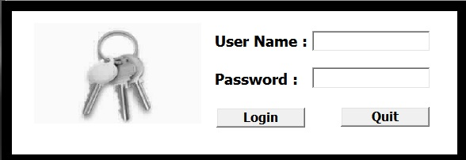

Slide 8


Slide 9
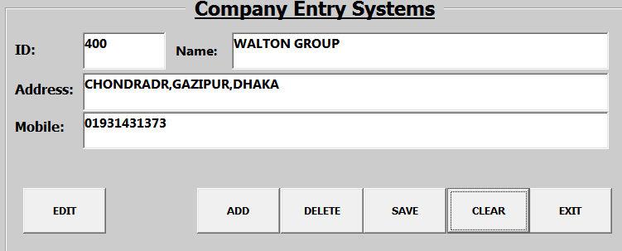

Slide 10
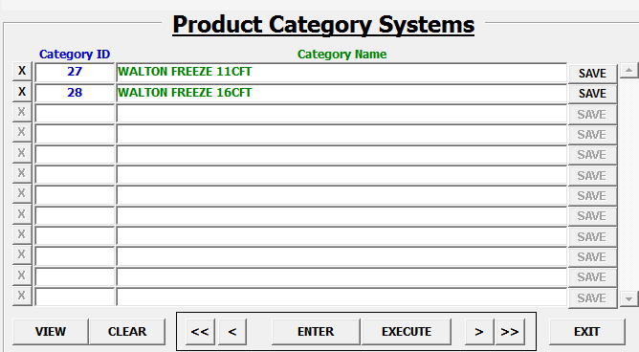

Slide 11
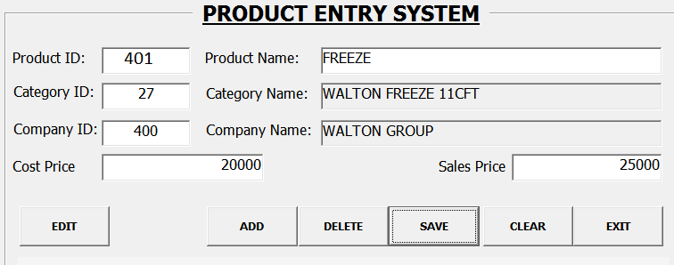

Slide 12
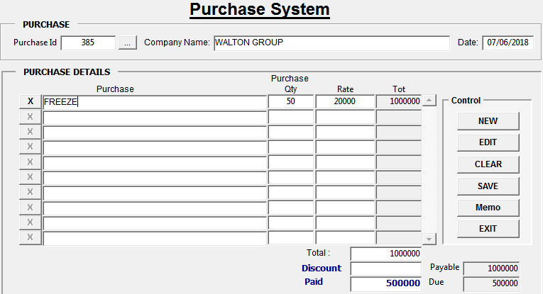

Slide 13
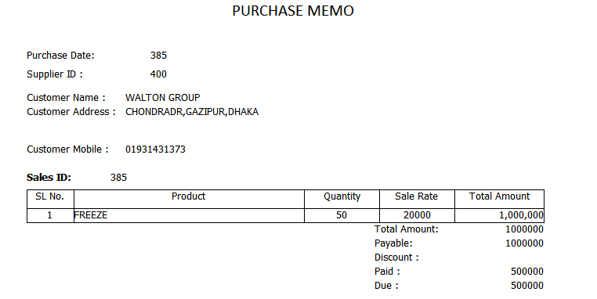

Slide 14
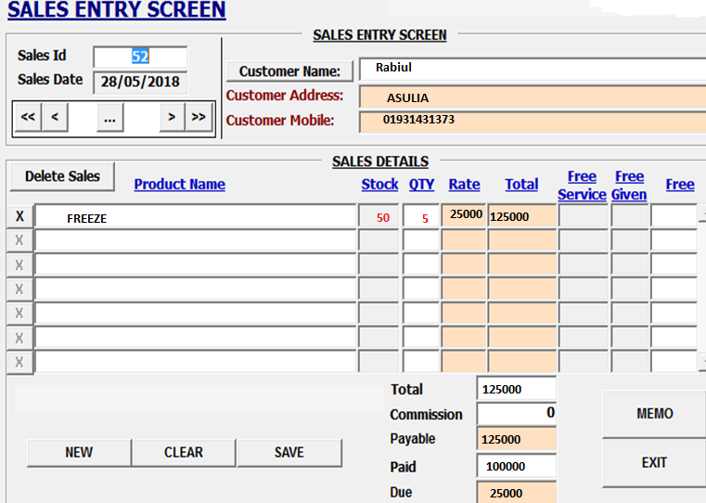

Slide 15
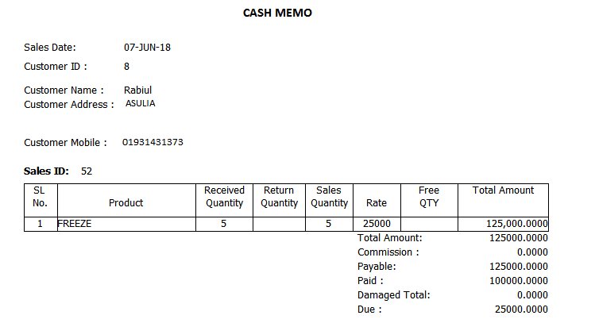

Slide 16
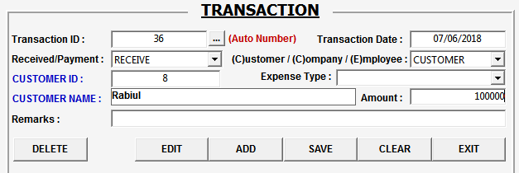

Slide 17
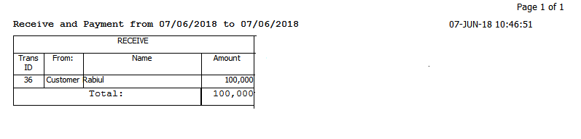

Slide 18
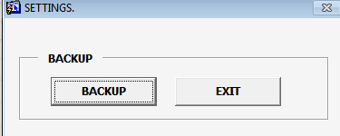

Slide 19
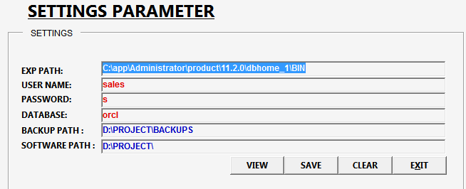

Slide 20
TOOLS and TECHNOLOGIES
ORACLE DATABASE 11G
DEVELOPER SUITE 6I
WINDOWS 7
SQL
PL/SQL
ADOBE READER

Slide 21
ADVANTAGES OF OUR SYSTEM
We do not use the traditional accounting term we use the simple mathematical term.
The system will make the middle size dealership business more faster with low cost
The system is exist but our goal is use this software for all kinds of sales businesses.
The owner can monitor the total business transaction system from his office.

Slide 22
LIMITATION OF THE SYSTEM
The system need a high amount of storage in Ram
Need a well configured hardware tools

Slide 23
FUTURE DEVELOPMENT
Existing system is desktop based we will make it mobile base.
Live supporting system will be provided for the next version

Slide 24
THANK YOU

